Slide 1
Design Patterns

Slide 2
Agenda
Software Craftsmanship Manifesto
Good Practices
Fluent Interface/Fluent API
Origin of Patterns
Gang of Four Patterns
Clasification and types
Creational Patterns
Structural Patterns
Behavioral Patterns
Further reading

Slide 3
Software Craftsmanship Manifesto

Slide 4
Software Craftsmanship Manifesto
​The signatories of Craft Software manifesto, calling yourself Software Craftsmen, emphasized the following values:
Not only working software, but also well-crafted software
Not only responding to change, but also steadily adding value
Not only individuals and interactions, but also a community of professionals
Not only customer callaboration, but also productive partnerships

Slide 5
Good Practices

Slide 6
SOLID

Slide 7
SOLID
​ SOLID is a mnemonic acronym for five design principles intended to make software designs more understandable, flexible and maintainable. The principles are a subset of many principles promoted by American software engineer and instructor Robert C. Martin.

Slide 8
SOLID - Concepts
Single responsibility principle
A class should have only a single responsibility, that is, only changes to one part of the software's specification should be able to affect the specification of the class.
Open-closed principle
Classes should be open for extension, but closed for modification.
Liskov substitution principle
Objects in a program should be replaceable with instances of their subtypes without altering the correctness of that program.
Interface segregation principle
Many client-specific interfaces are better than one general-purpose interface.
Dependency inversion principle
One should depend upon abstractions, not on the details.

Slide 9
KISS

Slide 10
KISS
​KISS is an acronym for "keep it simple stupid". The KISS principle states that most systems work best if they are kept simple rather than made complicated. Simplicity should be a key goal in design, and unnecessary complexity should be avoided.

Slide 11
DRY

Slide 12
DRY
​DRY (don't repeat yourself) is a principle of software development aimed at reducing repetition of software patterns, replacing it with abstractions or using data normalization to avoid redundancy. The principle has been formulated by Andy Hunt and Dave Thomas in their book The Pragmatic Programmer. WHEN the DRY principle is applied successfully, a modification of any single element of a system does not require a change in other logically unrelated elements.

Slide 13
YAGNI

Slide 14
YAGNI
YAGNI ("You aren't gonna need it") is a principle of extreme programming that states a programmer should not add functionality until deemed necessary. Ron Jeffries (one of the three founders of the Extreme Programming) has written: "Always implement things when you actually need them, never when you just foresse that you need them."

Slide 15
Law of Demeter

Slide 16
Law of Demeter
The Law of Demeter (LoD) or principle of least knowledge is a design guideline for developing software, particularly object-oriented programs. Was proposed by Ian Holland at Northeastern University.
Each unit should have only limited knowledge about other units: only units "closely" related to the current unit.
Each unit should only talk to its friends, don't talk to strangers.
Only talk to your immediate friends.
LoD was named in honor of Demeter, "distribution-mother" and the Greek goddess of agriculture, to signify a bottom-up philosophy of programming which is also embedded in the law itself.

Slide 17
Clean Code

Slide 18
Clean Code
​"Clean code is simple and direct. Clean code reads like well-written prose. Clean code never obscures the designer's intent but rather is full of crisp abstractions and straightforward lines of control."
Grady Booch, author of Object Oriented Analysis
and Design with Aplplications

Slide 19
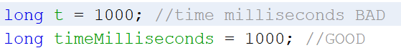
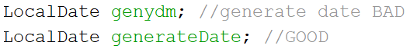
Clean Code – Meaningful Names
Use intention revealing names
Avoid Disinformation
Entities named different, should be different, mean different
Use pronounceable names
Avoid single letter variables and constants as they are difficult to search
Classes and objects should have noun or noun phrase names like Customer, Account, Car, Animal
Methods should have verb or verb phrase names like postPayment, deletePage or save
Pick one word for one abstract concept and stick with it

Slide 20
Clean Code – Functions, Comments, Error handling
Functions
Short as possible (max 20 lines)
Preferably without or one argument
Single responsibility
One level of abstraction
try{} catch{} blocks in a separate function
Comments
Little as possible
Allowed comments: TODO, warning
Let's not leave commented code snippets
Error handling
Exceptions instead of return codes
Stop returning null
Stop transfering null

Slide 21
Fluent Interface

Slide 22
Fluent Interface
​ Fluent interface means to build a project in such way so that it meets the following criteria:
User can understand interface very easily
Interface can perform a series of actions in order to finish a task
Each method's name should be domain-specific terminology
Interface should be suggestive enough to guide users on what to do next and what possible operations can take at a particular moment

Slide 23
Fluent Interface
EXAMPLE

Slide 24
Origin of Patterns

Slide 25

Christopher Alexander

Slide 26

A Pattern Language

Slide 27
The Pattern Definition
​The elements of this language are entities called patterns. Each pattern describes a problem that occurs over and over again in our environment, and then describes the core of the solution to that problem, in such a way that you can use this solution a million times over, without ever doing it the same way twice.

Slide 28
Gang of Four

Slide 29
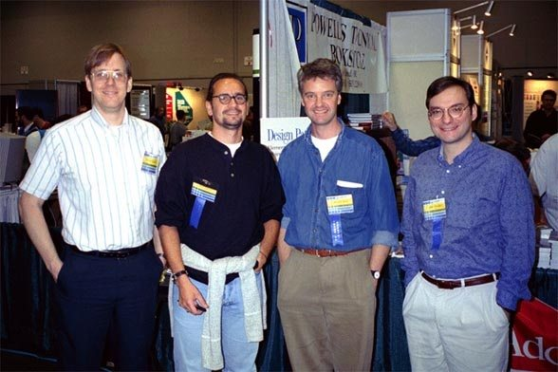
The "Gang of Four"
Erich Gamma, Richard Helm, Ralph Johnson, John Vlissides

Slide 30
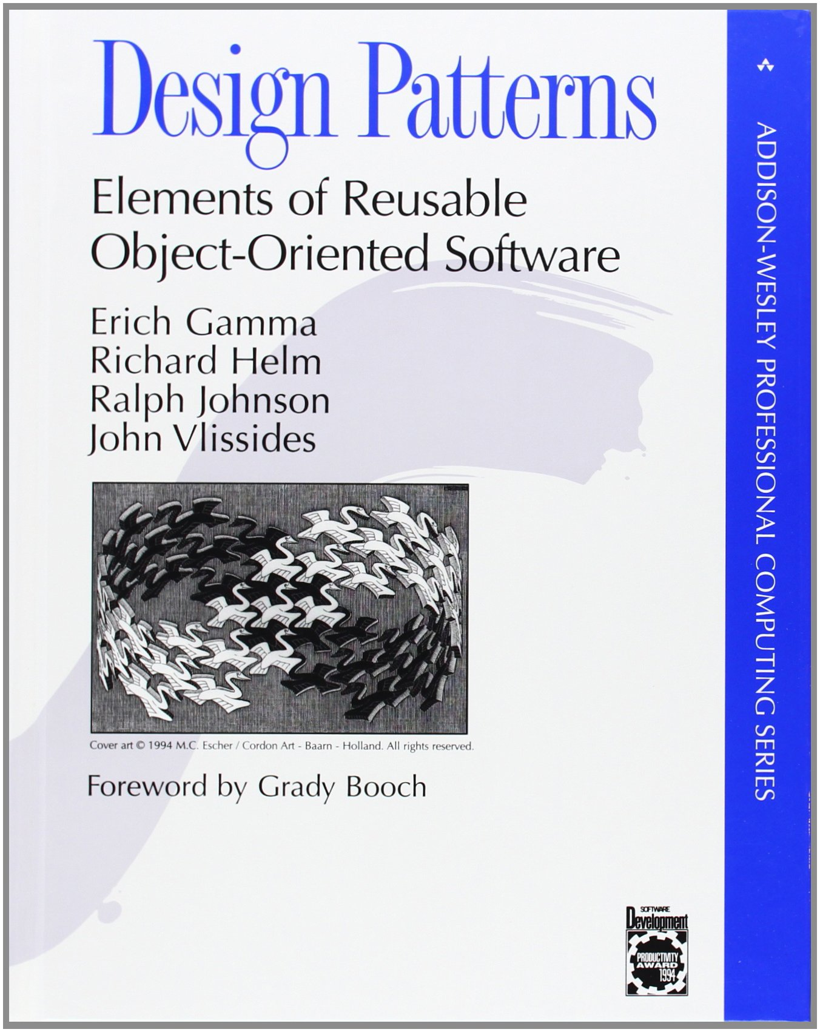
The Design Patterns Book
The design patterns in this book are descriptions of communicating objects and classes that are customized to solve a general design problem in a particular context.

Slide 31
Clasification and types

Slide 32
Basic Ingredients of a Pattern
context - a design situation giving rise to a design problem
problem - a set of forces occurring in that context
solution - a form or rule that can be applied to resolve these forces

Slide 33
Types of Design Patterns
architectural - high-level strategies that are concerned with large-scale components and global properties and mechanisms of a system
design patterns - medium-level strategies that are concerned with the structure and behavior of entities, and their relationships
idioms - paradigm-specific and language-specific programming techniques that fill in low-level internal or external details of a component’s structure or behavior

Slide 34
Categories of Design Patterns
creational - used to construct objects such that they can be decoupled from their implementing system
structural - used to form large object structures between many disparate objects
behavioral - used to manage algorithms, relationships, and responsibilities between objects

Slide 35
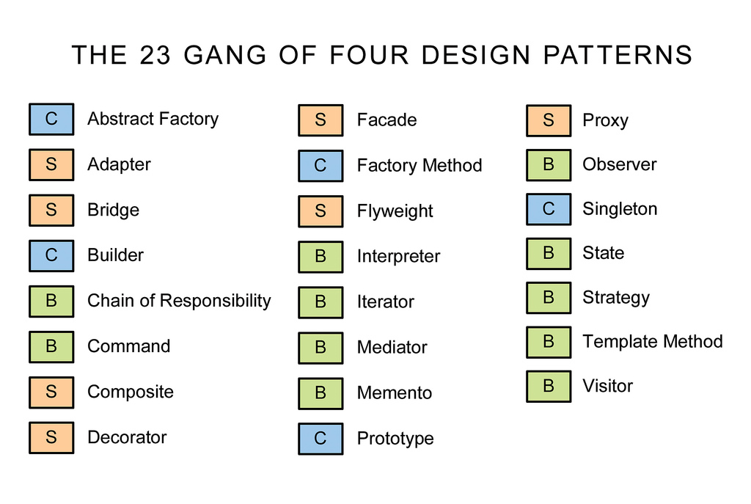
The 23 Gang of Four Design Patterns

Slide 36
Creational Patterns

Slide 37
Creational Patterns
Abstract Factory (aka Kit)
Builder
Factory Method
Prototype
Singleton

Slide 38
Abstract Factory
Creational Patterns

Slide 39
Abstract Factory
Provide an interface that delegates creation calls to one or more concrete classes in order to deliver specific objects.
the creation of objects should be independent of the system utilizing them
systems should be capable of using multiple families of objects
families of objects must be used together
libraries must be published without exposing implementation details
concrete classes should be decoupled from clients

Slide 40
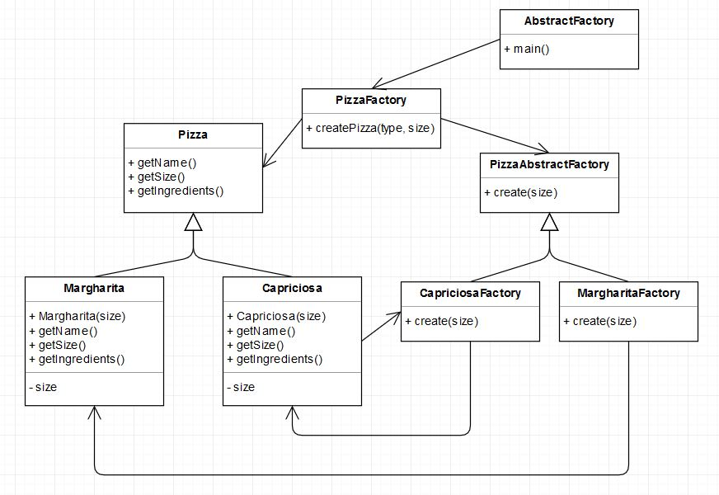
Abstract Factory - diagram

Slide 41
Abstract Factory
EXAMPLE

Slide 42
Abstract Factory - exercises
Create new class that inherits from Pizza class (eg FruttiDiMare).
Create factory implementing the PizzaAbstractFactory interface.
Modify PizzaFactory production class by adding the newly created factory class.

Slide 43
Builder
Creational Patterns

Slide 44
Builder
Allows for the dynamic creation of objects based upon easily interchangeable algorithms.
object creation algorithms should be decoupled from the system
multiple representations of creation algorithms are required
the addition of new creation functionality without changing the core code is necessary
runtime control over the creation process is required

Slide 45
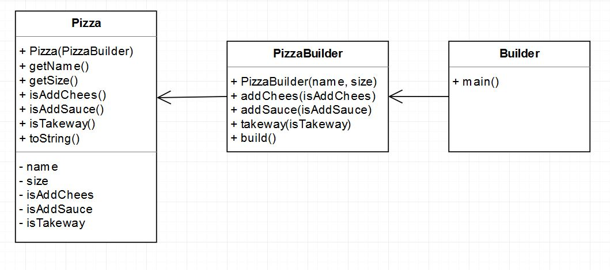
Builder - diagram

Slide 46
Builder
EXAMPLE

Slide 47
Builder - exercises
Create new Block class with the name, shape, color, penWidth properties.
Create builder class using previously created class.

Slide 48
Factory Method
Creational Patterns

Slide 49
Factory Method
Exposes a method for creating objects, allowing subclasses to control the actual creation process.
a class will not know what classes it will be required to create
subclasses may specify what objects should be created
parent classes wish to defer creation to their subclasses

Slide 50
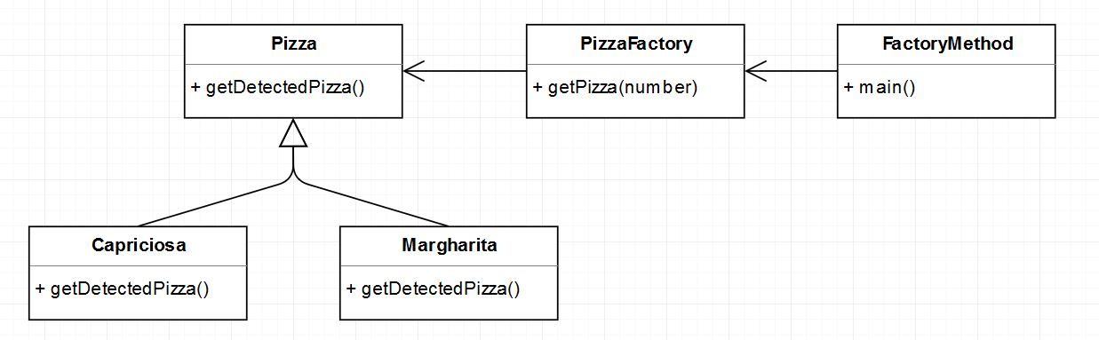
Factory Method - diagram

Slide 51
Factory Method
EXAMPLE

Slide 52
Factory Method - exercises
Create FruttiDiMare class implementing the Pizza interface.
Modify getPizza method in PizzaFactory class.

Slide 53
Prototype
Creational Patterns

Slide 54
Prototype
Used when the type of objects to create is determined by a prototypical instance, which is cloned to produce new objects.
avoid subclasses of an object creator in the client application, like the factory method pattern does
avoid the inherent cost of creating a new object in the standard way

Slide 55
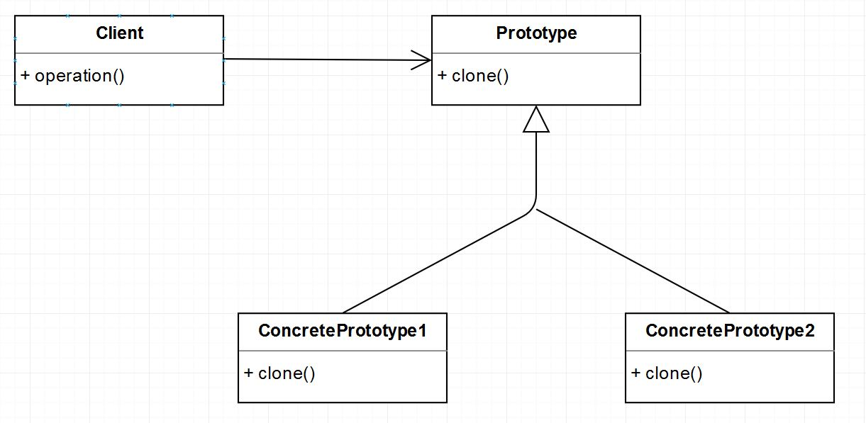
Prototype - diagram

Slide 56
Singleton
Creational Patterns

Slide 57
Singleton
Ensures that only one instance of a class is allowed within a system.
exactly one instance of a class is required
controlled access to a single object is necessary

Slide 58
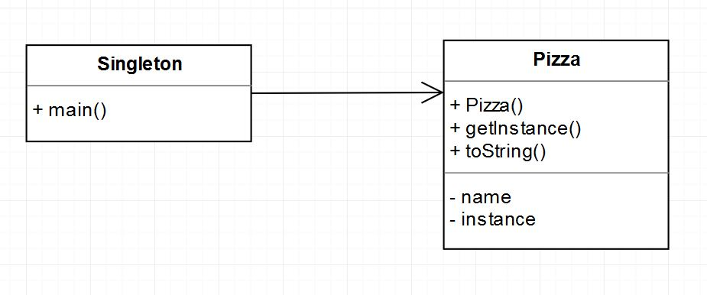
Singleton - diagram

Slide 59
Singleton
EXAMPLE

Slide 60
Singleton - exercises
Create Animal class that will be a Singleton.
Add type property.
Call newly-created object several times, modify type.

Slide 61
Structural Patterns

Slide 62
Structural Patterns
Adapter (aka Wrapper)
Bridge
Composite
Decorator (aka Wrapper)
Facade
Flyweight
Proxy (aka Surrogate)

Slide 63
Adapter
Structural Patterns

Slide 64
Adapter
Permits classes with disparate interfaces to work together by creating a common object by which they may communicate and interact.
a class to be used doesn’t meet interface requirements
complex conditions tie object behavior to its state
transitions between states need to be explicit

Slide 65
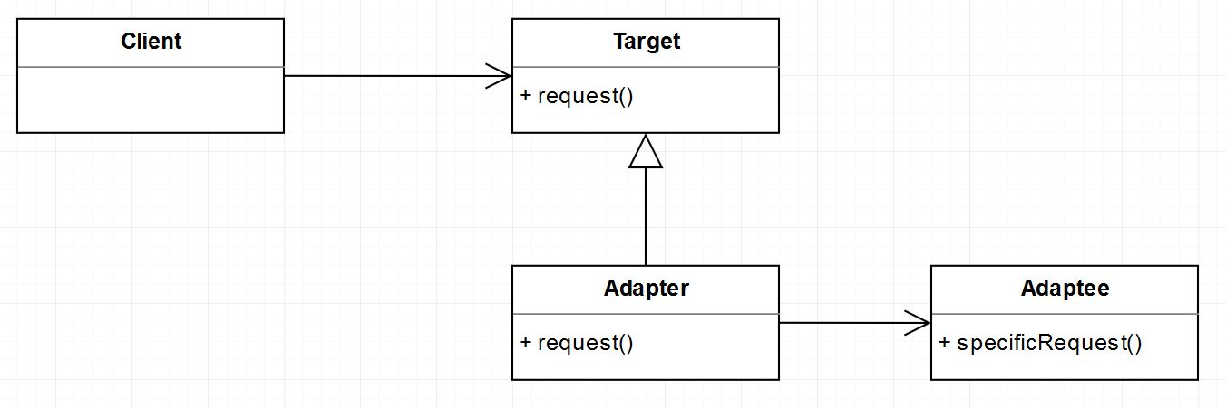
Adapter - diagram

Slide 66
Bridge
Structural Patterns

Slide 67
Bridge
Defines an abstract object structure independently of the implementation object structure in order to limit coupling.
abstractions and implementations should not be bound at compile time
abstractions and implementations should be independently extensible
changes in the implementation of an abstraction should have no impact on clients
implementation details should be hidden from the client

Slide 68
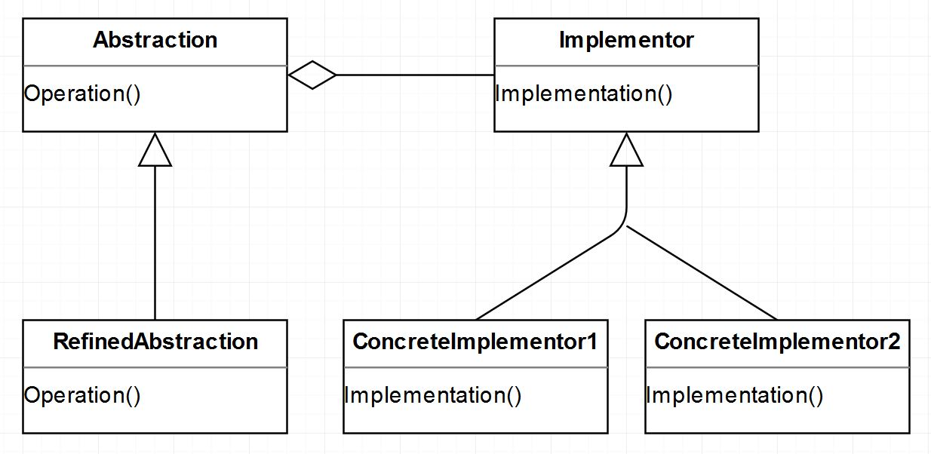
Bridge - diagram

Slide 69
Composite
Structural Patterns

Slide 70
Composite
Facilitates the creation of object hierarchies where each object can be treated independently or as a set of nested objects through the same interface.
hierarchical representations of objects are needed
objects and compositions of objects should be treated uniformly

Slide 71
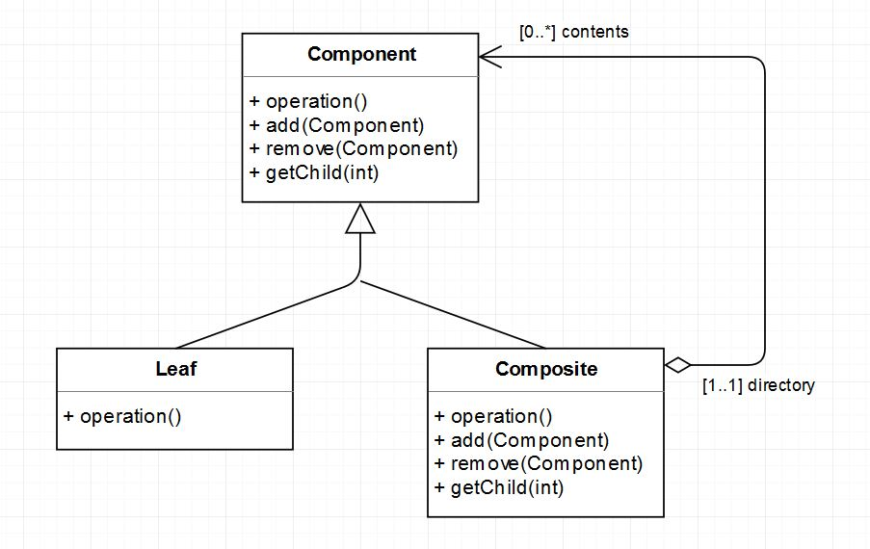
Composite - diagram

Slide 72
Decorator
Structural Patterns

Slide 73
Decorator
Allows for the dynamic wrapping of objects in order to modify their existing responsibilities and behaviors.
object responsibilities and behaviors should be dynamically modifiable
concrete implementations should be decoupled from responsibilities and behaviors
subclassing to achieve modification is impractical or impossible
specific functionality should not reside high in the object hierarchy
a lot of little objects surrounding a concrete implementation is acceptable

Slide 74
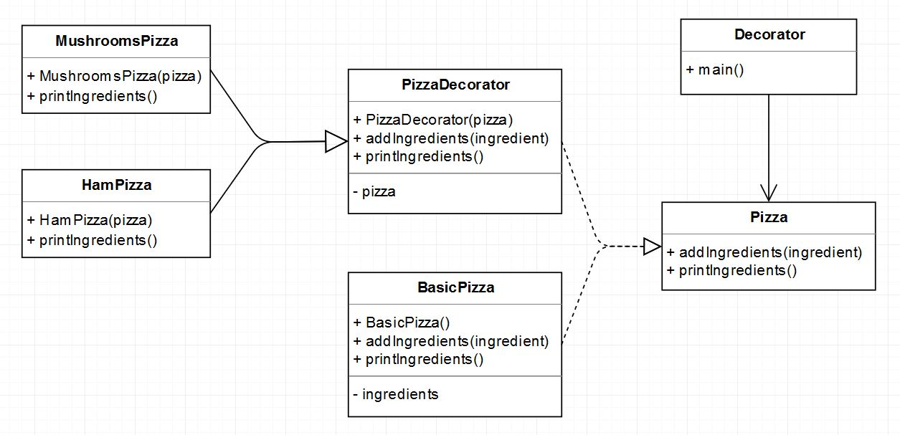
Decorator - diagram

Slide 75
Decorator
EXAMPLE

Slide 76
Decorator - exercises
Create SeafoodPizza class inheriting from the PizzaDecorator class.
Use newly created class to decorate BasicPizza class object.

Slide 77
Facade
Structural Patterns

Slide 78
Facade
Supplies a single interface to a set of interfaces within a system.
a simple interface is needed to provide access to a complex system
there are many dependencies between system implementations and clients
systems and subsystems should be layered

Slide 79
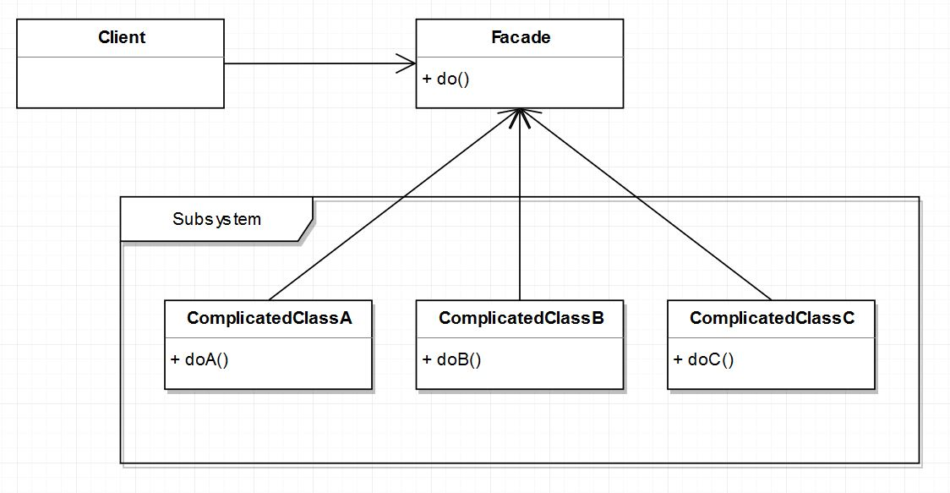
Facade - diagram

Slide 80
Flyweight
Structural Patterns

Slide 81
Flyweight
Facilitates the reuse of many fine grained objects, making the utilization of large numbers of objects more efficient.
many like objects are used and storage cost is high
the majority of each object’s state can be made extrinsic
a few shared objects can replace many unshared ones
the identity of each object does not matter

Slide 82
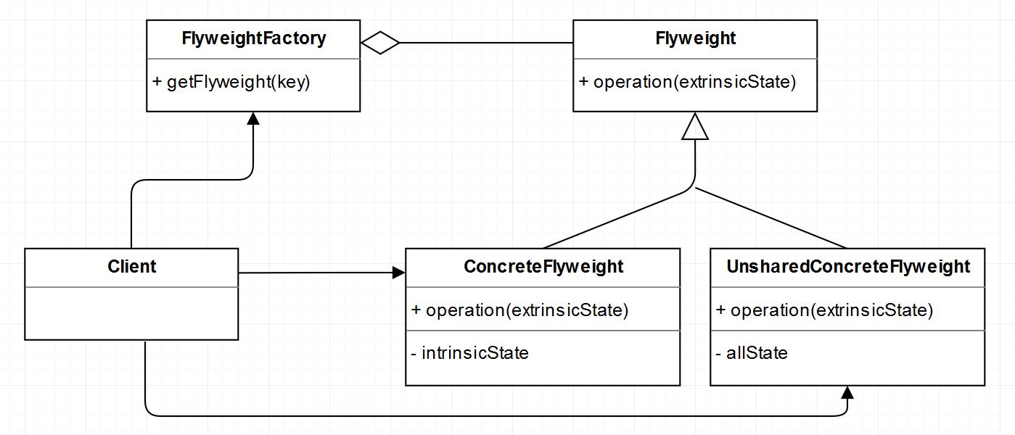
Flyweight - diagram

Slide 83
Proxy
Structural Patterns

Slide 84
Proxy
Allows for object level access control by acting as a pass through entity or a placeholder object.
the object being represented is external to the system
objects need to be created on demand
access control for the original object is required
added functionality is required when an object is accessed

Slide 85
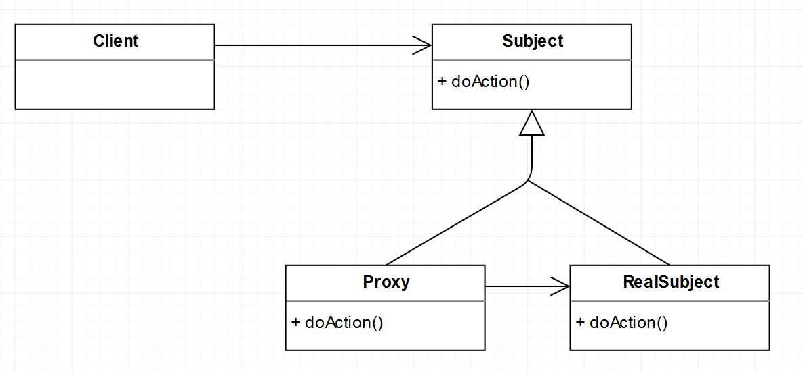
Proxy - diagram

Slide 86
Behavioral Patterns

Slide 87
Behavioral Patterns
Chain Of Responsibility
Command (aka Action, Transaction)
Interpreter
Iterator (aka Cursor)
Mediator
Memento (aka Token)
Observer
State
Strategy (aka Policy)
Template Method
Visitor

Slide 88
Chain of Responsibility
Behavioral Patterns

Slide 89
Chain of Responsibility
Gives more than one object an opportunity to handle a request by linking receiving objects together.
multiple objects may handle a request and the handler doesn’t have to be a specific object
a set of objects should be able to handle a request with the handler determined at runtime
a request not being handled is an acceptable potential outcome

Slide 90
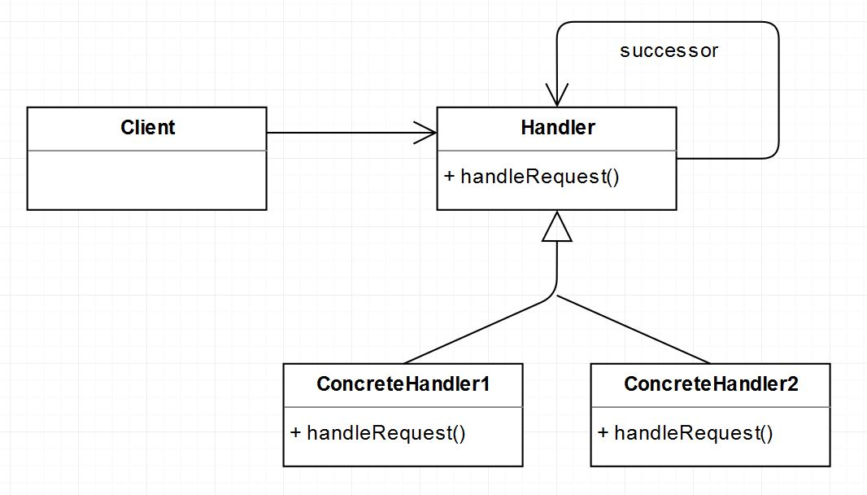
Chain of Responsibility - diagram

Slide 91
Command
Behavioral Patterns

Slide 92
Command
Encapsulates a request allowing it to be treated as an object. This allows the request to be handled in traditionally object based relationships such as queuing and callbacks.
you need callback functionality
requests need to be handled at variant times or in variant orders
a history of requests is needed
the invoker should be decoupled from the object handling the invocation

Slide 93
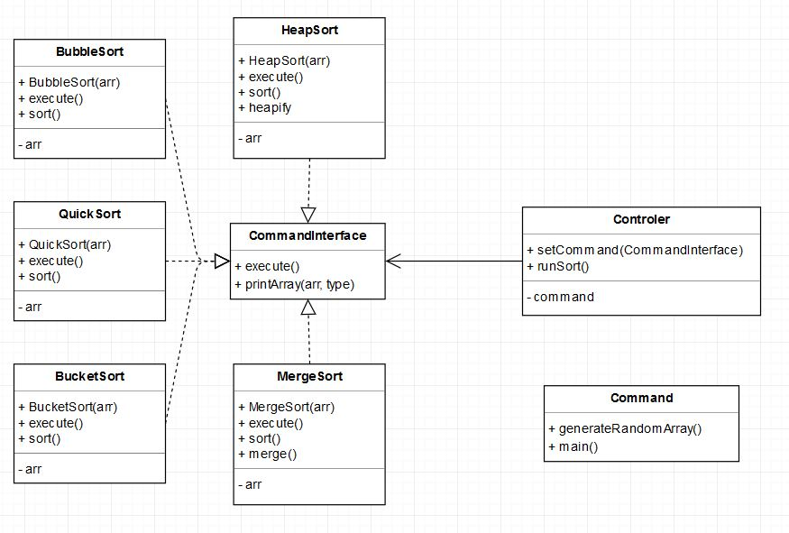
Command - diagram

Slide 94
Command
EXAMPLE

Slide 95
Command - exercises
Create ShellSort class implementing the CommandInterface interface.
In the ShellSort class, create a sort method, sorting an array of integers using the Shellsort algorithm.
Check the sorting speed, compare the result with other algorithms.

Slide 96
Interpreter
Behavioral Patterns

Slide 97
Interpreter
Defines a representation for a grammar as well as a mechanism to understand and act upon the grammar.
there is grammar to interpret that can be represented as large syntax trees
the grammar is simple
efficiency is not important
decoupling grammar from underlying expressions is desired

Slide 98
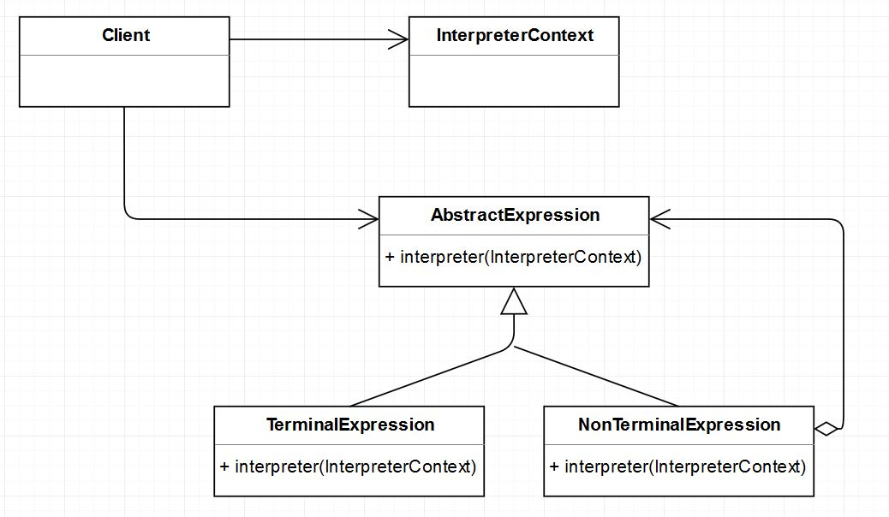
Interpreter - diagram

Slide 99
Iterator
Behavioral Patterns

Slide 100
Iterator
Allows for access to the elements of an aggregate object without allowing access to its underlying representation.
access to elements is needed without access to the entire representation
multiple or concurrent traversals of the elements are needed
a uniform interface for traversal is needed
subtle differences exist between the implementation details of various iterators

Slide 101
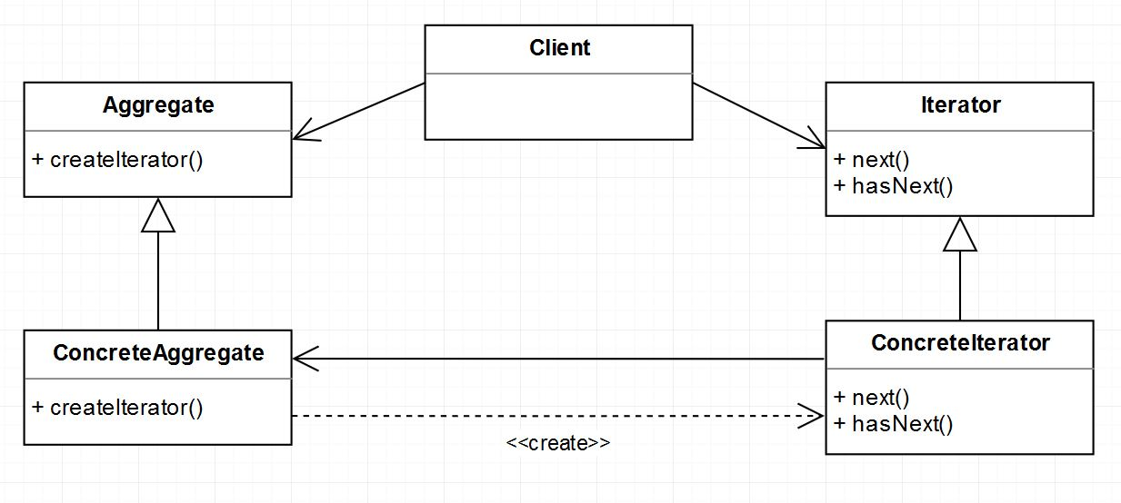
Iterator - diagram

Slide 102
Mediator
Behavioral Patterns

Slide 103
Mediator
Allows loose coupling by encapsulating the way disparate sets of objects interact and communicate with each other. Allows for the actions of each object set to vary independently of one another.
communication between sets of objects is well defined and complex
too many relationships exist and common point of control or communication is needed

Slide 104
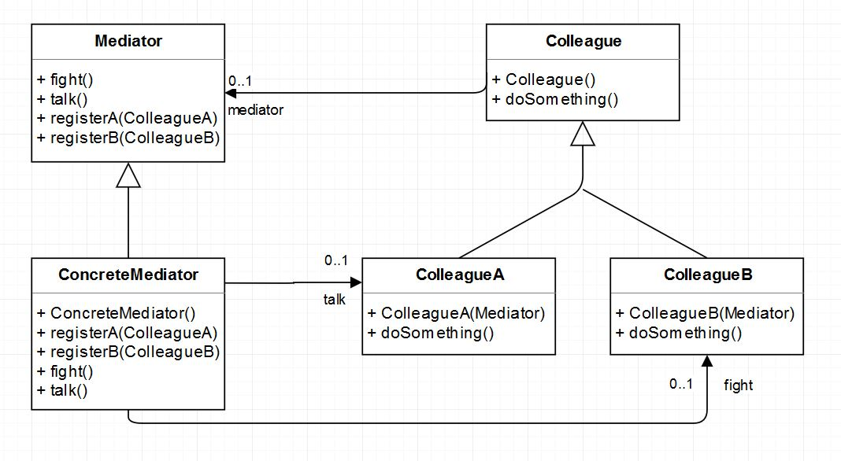
Mediator - diagram

Slide 105
Memento
Behavioral Patterns

Slide 106
Memento
Allows for capturing and externalizing an object’s internal state so that it can be restored later, all without violating encapsulation.
the internal state of an object must be saved and restored at a later time
internal state cannot be exposed by interfaces without exposing implementation
encapsulation boundaries must be preserved

Slide 107
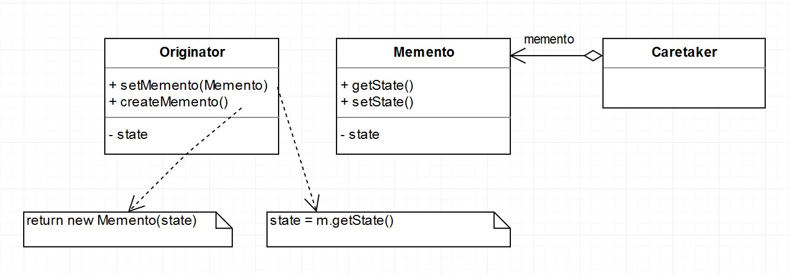
Memento - diagram

Slide 108
Observer
Behavioral Patterns

Slide 109
Observer
Let's one or more objects to be notified of state changes in other objects within the system.
state changes in one or more objects should trigger behavior in other objects
broadcasting capabilities are required
an understanding exists that objects will be blind to the expense of notification

Slide 110
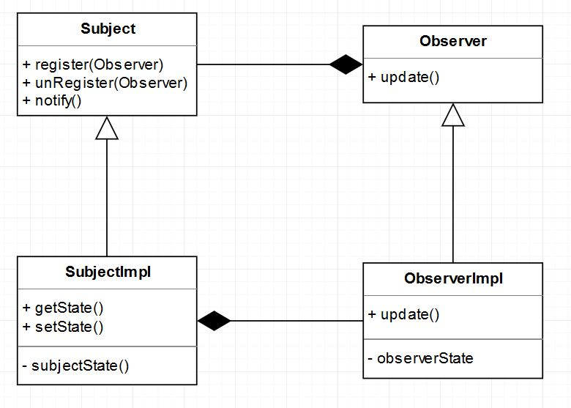
Observer - diagram

Slide 111
State
Behavioral Patterns

Slide 112
State
Ties object circumstances to its behavior, allowing the object to behave in different ways based upon its internal state.
the behavior of an object should be influenced by its state
complex conditions tie object behavior to its state
transitions between states need to be explicit

Slide 113
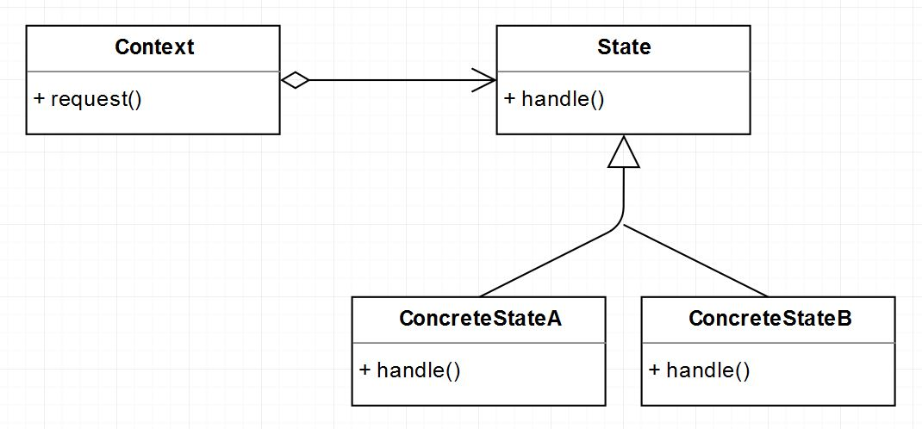
State - diagram

Slide 114
Strategy
Behavioral Patterns

Slide 115
Strategy
Defines a set of encapsulated algorithms that can be swapped to carry out a specific behavior.
the only difference between many related classes is their behavior
multiple versions or variations of an algorithm are required
algorithms access or utilize data that calling code shouldn’t be exposed to
the behavior of a class should be defined at runtime
conditional statements are complex and hard to maintain

Slide 116
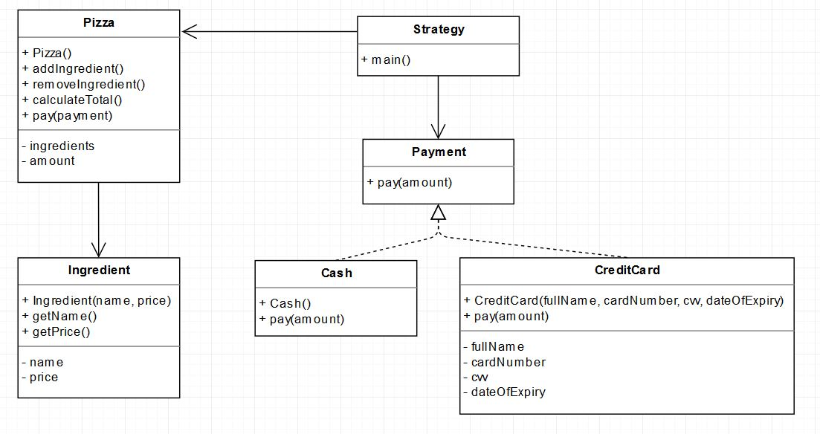
Strategy - diagram

Slide 117
Strategy
EXAMPLE

Slide 118
Strategy - exercises
Create new GooglePay class in implementing Payment that allows you to pay using GooglePay.
Modify the pay() method to give a 10% discount when paying with the GooglePay method.

Slide 119
Template Method
Behavioral Patterns

Slide 120
Template Method
Identifies the framework of an algorithm, allowing implementing classes to define the actual behavior.
a single abstract implementation of an algorithm is needed
common behavior among subclasses should be localized to a common class
parent classes should be able to uniformly invoke behavior in their subclasses
most or all subclasses need to implement the behavior

Slide 121
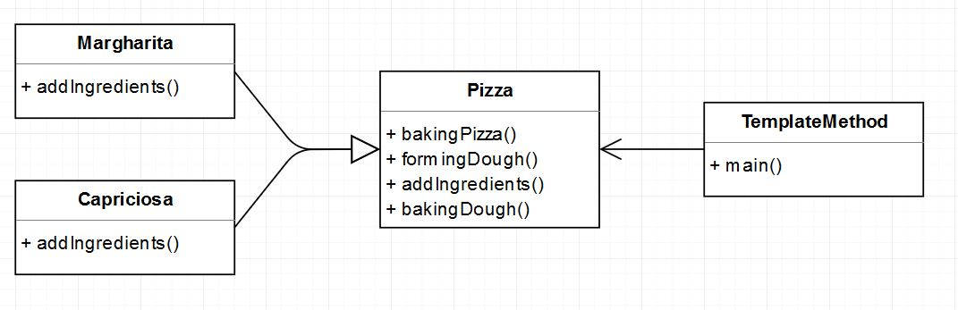
Template Method - diagram

Slide 122
Template Method
EXAMPLE

Slide 123
Template Method - exercises
Create a FruttiDiMare class inheriting from Pizza class.
Create class Sort in abstract method, two private randomArray and printArray methods, and one public sortArray.
Add two classes, BubbleSort and BucketSort inheriting from the Sort class.

Slide 124
Visitor
Behavioral Patterns

Slide 125
Visitor
Allows for one or more operations to be applied to a set of objects at runtime, decoupling the operations from the object structure.
an object structure must have many unrelated operations performed upon it
the object structure can’t change but operations performed on it can
operations must be performed on the concrete classes of an object structure
exposing internal state or operations of the object structure is acceptable
operations should be able to operate on multiple object structures that implement the same interface sets

Slide 126
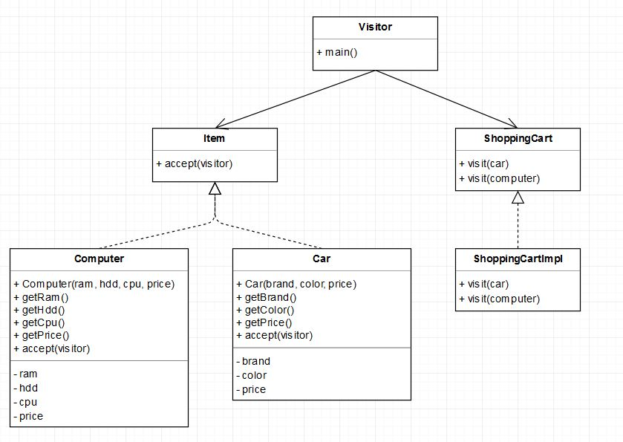
Visitor - diagram

Slide 127
Visitor
EXAMPLE

Slide 128
Visitor - exercises
Create an Animal class implementing the Item interface.
Modify the ShoppingCart interface by adding method whit parameter Animal.
To ShoppingCartImpl class add implementatnion of created method, for Dog type price will be reduced by 20$, while for Cat there be a rebate of 5$.

Slide 129
Further reading

Slide 130
Further reading
Head First Design Patterns
Design patterns: elements of reusable object-oriented software
Refactoring: Improving the Design of Existing Code
Refactoring to Patterns
Domain-Driven Design Distilled

Slide 131
Thank you for your attention!
© 2019 Software Development Academy All Rights Reserved

